Slide 1
2026 DOELAP External Dosimetry Assessor Training
The Oversight Board
Idaho Falls, ID
September 2026

Slide 2
DOELAP Process
Application
Site Office Approval
Review by STM
Performance Testing
On-Site Assessment
CAP
Review by Site Office
Review by Assessors
Review by STM
STM Recommendation
Oversight Board Review and Recommendation
DOELAP Administrator

Slide 3
Oversight Board (OSB) Organization
OSB roles and responsibilities are defined in DOE-STD-1111-2018.
Members are recognized as subject matter experts and are appointed by the DOELAP Administrator for five-year terms but may be reappointed to subsequent terms.
Starting in 2022, a single OSB was formed with subject matter experts from both Personnel Dosimetry and Radiobioassay subject areas.
The Board meets at least once a year to review laboratory accreditation documentation.
Additional meetings may take place on an ad hoc basis to discuss emerging issues, technical equivalency recommendations, etc.

Slide 4
Current Board Members
Chair – Milan Gadd, LANL
Mike Souleyrette, Y-12
Kelly Crandall, SRNL
Cheryl Antonio, Hanford
Nathan Elliott, SNL
Richard Pierson, PNNL
Adam Stavola, JLAB
Julia Strock, INL
Ken Veinot, Y-12
Jaime Daum, ORNL

Slide 5
OSB Functions and Responsibilities
Established through DOE-STD-1111-2018, Department of Energy Laboratory Accreditation Program Administration
The Board is an advisory body and decisions are not binding on the DOELAP Administrator but do carry significant weight.
The primary purpose of the Board is to support to the DOELAP Administrator to ensure the technical quality and consistency of DOELAP standards and on-site assessments.

Slide 6
OSB Functions and Responsibilities
Reviews recommendations made by the STM and advises the DOELAP Administrator regarding approval or denial of DOE or DOE contractor external dosimetry or radiobioassay programs.
OSB members abstain from voting on any issues where there may be a conflict of interest.
Evaluates the performance testing laboratory triennially for traceability of equipment and standards to the National Institute of Standards and Technology (NIST) and conformance with operating procedures.
Recommends to the DOELAP Administrator appropriate changes to the DOELAP program based on review of DOELAP documentation, on-site assessment criteria, and standards.

Slide 7
Oversight Board Functions and Responsibilities
The Board may review Technical Equivalence (TE) requests, as necessary
The Board may make recommendations to the Administrator regarding changes in the DOELAP program or PTL policy or procedures
The Board also offers the Administrator advice and information regarding new dosimeter technologies and standards development that may affect DOE dosimetry programs
Notes:
Current topics include accreditation of hybrid and electronic dosimeters.

Slide 8
Accreditation Package Review
The OSB reviews overall results from the performance test session(s).
The DOELAP STM prepares accreditation packages that include the following:
  STM recommendation
  Applications
  Performance test results
  Onsite assessment report
  Corrective action plan(s) for Deficiencies and Concerns
  Concurrence memos from the site field office regarding the application and corrective action plans
  Any other pertinent information

Slide 9
Accreditation Package Review
Application:
  Are sections properly completed, including addressing all elements and questions?
  Does the application adequately describe processes that were performance tested?
  Do the answers demonstrate the applicant is knowledgeable about the processes?
  Are detection limits consistent with process descriptions?

Slide 10
Accreditation Package Review
Performance Test (PT) Results:
  Did the PT meet criteria in the ANSI standards?
  Are results within the acceptance criteria?
  If there was a failure, was there an investigation and corrective actions?*
Notes:
* This should be addressed in the assessment report and/or information provided by the STM.

Slide 11
Accreditation Package Review
Assessment Report:
  Were past concerns and deficiencies addressed?
  Did the assessment review the processes and measurement systems included in the application?
  Are observations, concerns, and deficiencies consistent with DOELAP requirements?
  Do findings indicate larger issues with the program?
  Do findings have sufficient detail to clearly describe the issue(s)?
  Are there multiple observations or concerns on similar issues that may indicate a larger problem?
  Were there findings that are repeats or similar to previous years?
  May contact assessors for clarification.
Notes:
The OSB relies on the assessment report and findings of the on-site assessors. It does not reassess the site, but may apply knowledge from previous assessments or other information.

Slide 12
Accreditation Package Review
Corrective Action Plan:
  Were all deficiencies and concerns addressed?
  Do the corrective actions indicate understanding and consideration of the issue or do they just “correct the immediate issue”?
  Are corrective actions appropriate and timely?
Notes:
Actions >1 year are looked at closely for adequate justification

Slide 13
Accreditation Recommendations
The OSB makes recommendations to the DOELAP Administrator to grant or deny accreditation.
The OSB may recommend accreditation be contingent on completion of retesting, providing additional information to the STM, modification of corrective actions, or performing additional actions.
The OSB may recommend a follow-up visit.

Slide 14
Triennial PTL Review
Conducted in a similar fashion as the site assessments
Administrative Management
  Records, Staffing, Training
Quality Assurance
  Documentation, Internal reviews, Software & Hardware Configuration Management
Traceability
  Calibration Records
  Traceability of solutions and fields to NIST

Slide 15
Triennial PTL Review
Performance Testing Process
  Consistency with ANSI N13.11-2022, ANSI N13.32-2018, ANSI N13.30-2011(R2017)
  Consistency with DOE-STD-1095-2025 and DOE-STD-1112-2019
  Procedures for preparing test samples, receiving, exposing and returning dosimeters
Review of the previous report and any corrective actions that were warranted
A formal report is issued

Slide 16
The OSB
Does:
Review accreditation packages and advise on accreditation.
Provide a broad view of the assessments and program.
Provide historical knowledge.
Advise DA and STM on issues affecting the DOELAP program.
Assess the PTL.
Does not:
Reassess the program
Set DOELAP policy
Evaluate adequacy of a sites program design (detection limits, monitoring frequency, sample types, etc.)**
Notes:
** This is normally the responsibility of the site and their DOE Field element. However, a DOELAP assessor may have expertise to recognize where a program may not be sufficient to show compliance with the criteria in 10 CFR 835. Such issues must be addressed with extreme caution. Stay within the scope of the DOELAP standards.

Slide 17
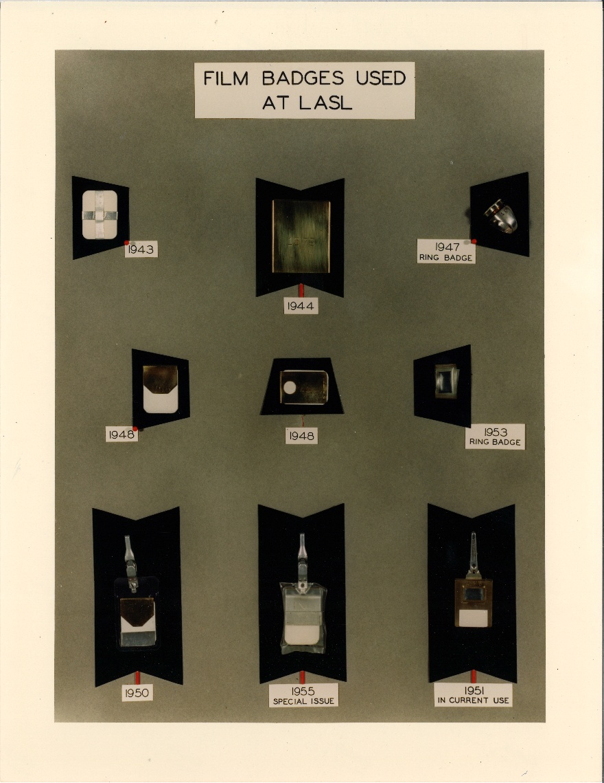
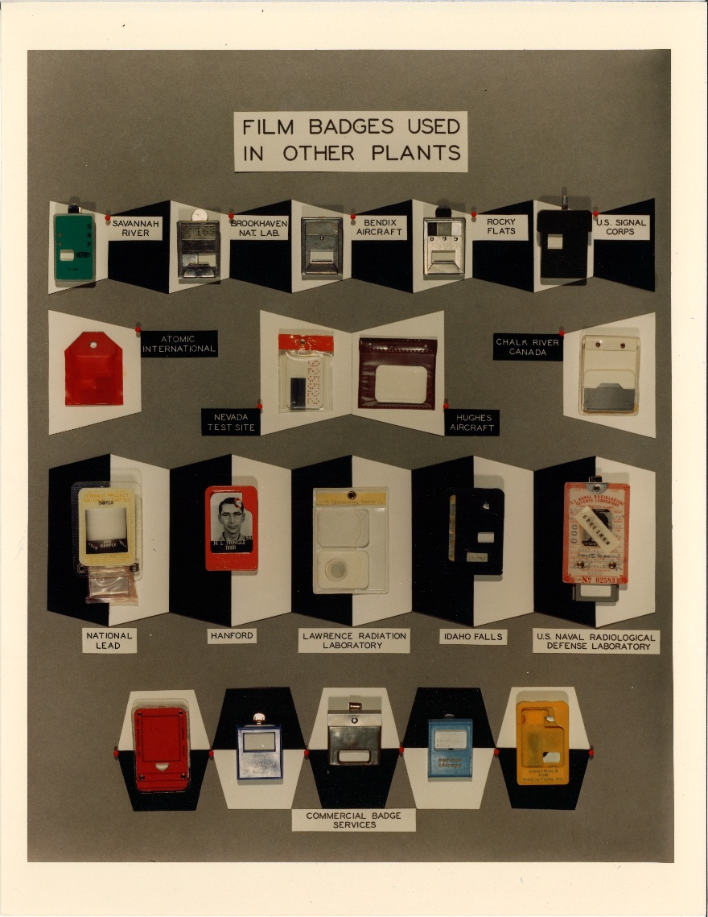
Questions?

